Slide 1

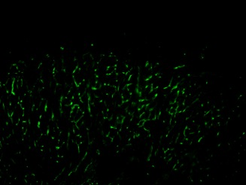
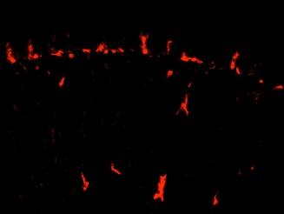
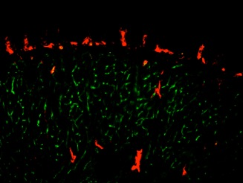
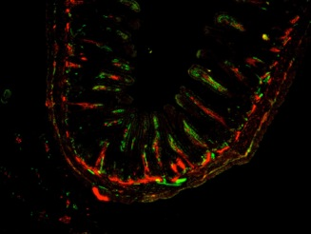
ReliaTech GmbH
Rat anti-mouse LEC26 / Bec12
(LEC26: Cat #103-M152; BEC12: Cat# 103-M154)
Immunofluorescence staining of BEC12/LA5 (green) [Cat# 103-M154] and LEC26/LA102 (red) [Cat# 103-M152] in the tongue and small intestine from C57BL/6 female mice. Fresh frozen cryosections (10 micron thick) were fixed with acetone for 10 min at RT and then reacted directly with Biotin-conjugated LA102 followed by streptoavidin-Cy3 (red) and Alexa488 labeled LA5 (green) for double staining.
The experiments were performed by the research group of Prof. T. Ezaki, TWMU, Tokyo, Japan.
BEC12 (LA5): Tongue (green) 100X
LEC26 (LA102): Tongue (red) 100X
K22973
K22974
Tongue Merged (LA102vsLA5) 100X
Small Intestine Merged (LA102vsLA5) 40X
http://www.reliatech.de / orders@reliatech.de

